Slide 1
What Makes People Happy?
Lauren Gardner, Danica Tiegs, Stacey Wai, Siara Leininger and Courtney Muhlbach

Slide 2
Main Question
What factors play into how happy people are?
Specifically, can we use data on alcohol consumption, health, and other social factors to predict how happy people in specific countries are?

Slide 3
Data Sources Used
We pulled data about various countries from the following locations:
World Health Organization (WHO) - Global Information System on Alcohol and Health
World Health Organization (WHO) – Life Expectancy and Health Data
Gallup Word Poll (GWP) – Happiness

Slide 4
Methods Explored
Unsupervised Learning
Method: Clustering
Goals:
Explore the data
Identify groups
Find trends in each group
Supervised Learning
Method: Multiple Linear Regression
Goals:
Determine which features impact happiness

Slide 5
Correlation Matrix

Slide 6
Clustering

Slide 7
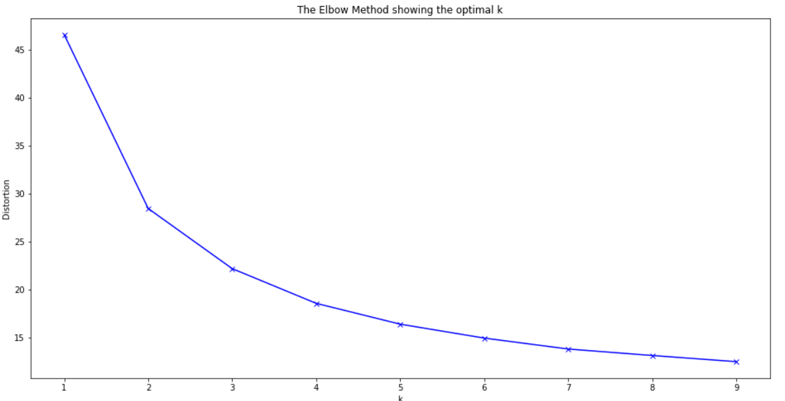
Elbow Method
Concave part of the elbow determines the clusters needed

Slide 8
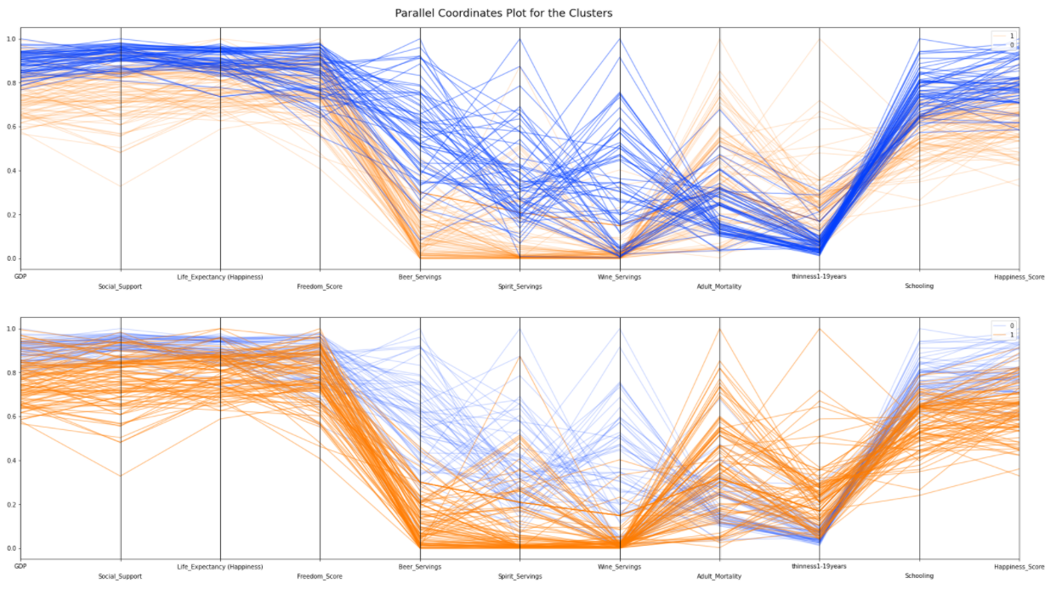
Parallel Coordinates
Maps the centroid of each cluster

Slide 9
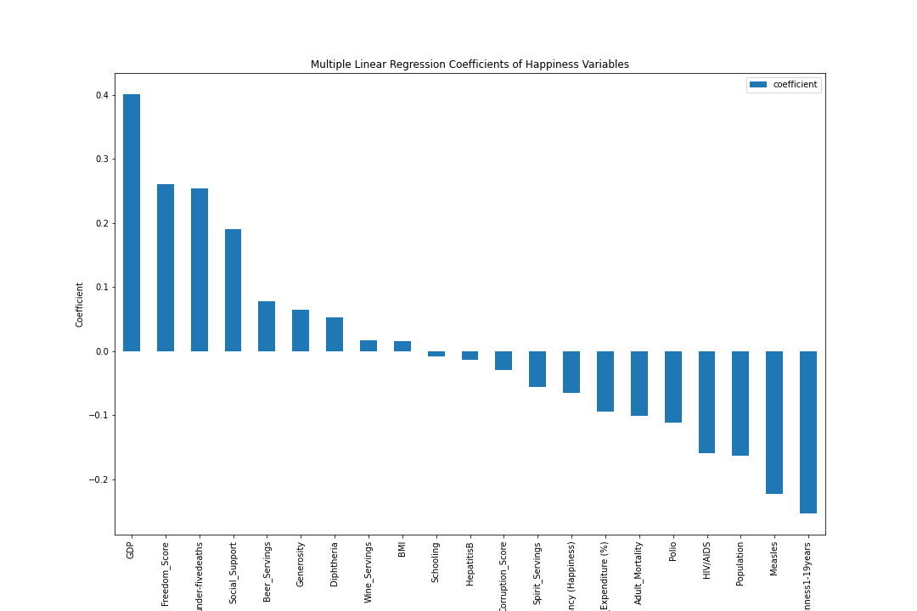
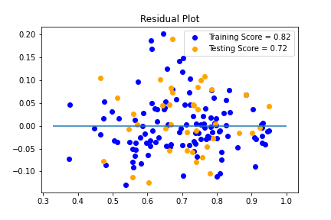
Multiple Linear Regression
Notes:
Positive - GDP, Freedom, <5 Deaths, Social Support
Negative - Thinness 1-19 years, Measles, Population, HIV/AIDs, Polio, Adult Mortality

Slide 10
Conclusions

